Slide 1
Alternating Current (ac) Voltage

Slide 2
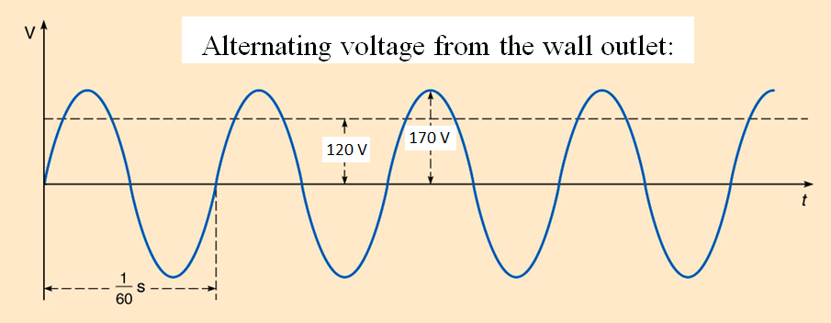
Alternating Current (ac) Voltage

Slide 3
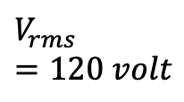
Alternating Current (ac) Voltage
$$V_{rms}=120 volt$$

Slide 4
Alternating Current (ac) Voltage
$$V_{p}=170 volt$$

Slide 5
Alternating Current (ac) Voltage
$$V_{p}=170 volt$$
$$V_{rms}=120 volt$$
$$V=V_{p}\sin{ωt}$$
$$ω=2πf$$

Slide 6
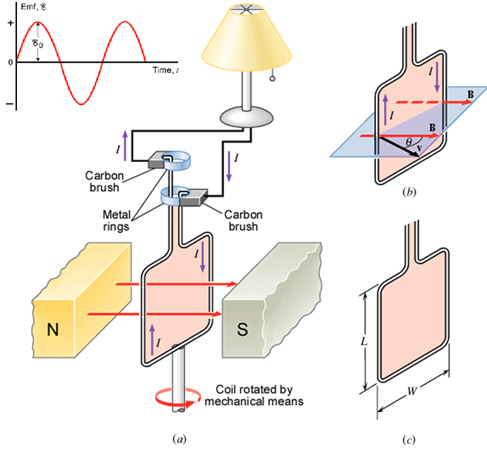
AC generator

Slide 7
AC generator

Slide 8
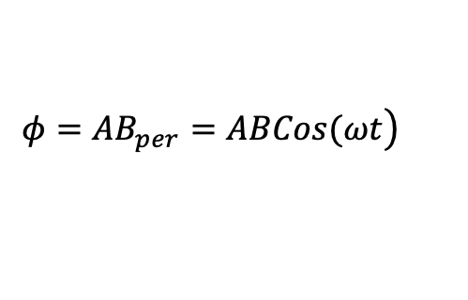
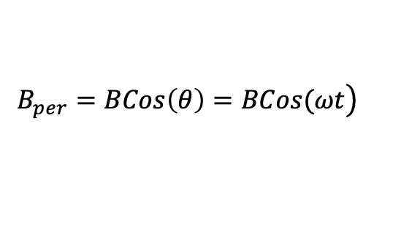
AC generator
$$\left.B_{per}=BCos\left(θ\right)=BCos(ωt\right)$$
$$\left.φ=AB_{per}=ABCos(ωt\right)$$

Slide 9
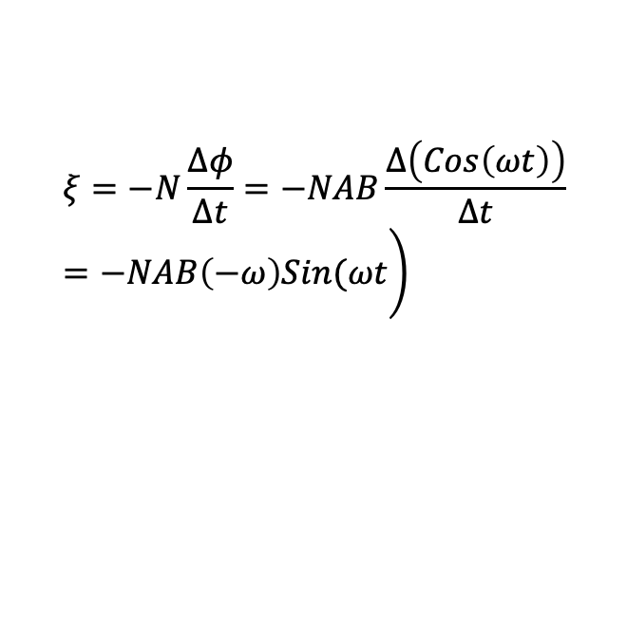
AC generator
$$\left.B_{per}=BCos\left(θ\right)=BCos(ωt\right)$$
$$\left.φ=AB_{per}=ABCos(ωt\right)$$
$$\left.ξ=−N\frac{Δφ}{Δt}=−NAB\frac{Δ\left(Cos\left(ωt\right)\right)}{Δt}=−NAB\left(−ω\right)Sin(ωt\right)$$

Slide 10
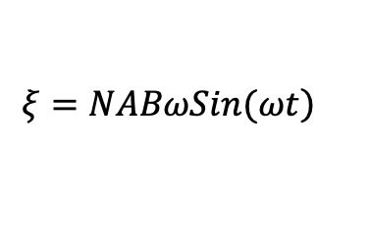
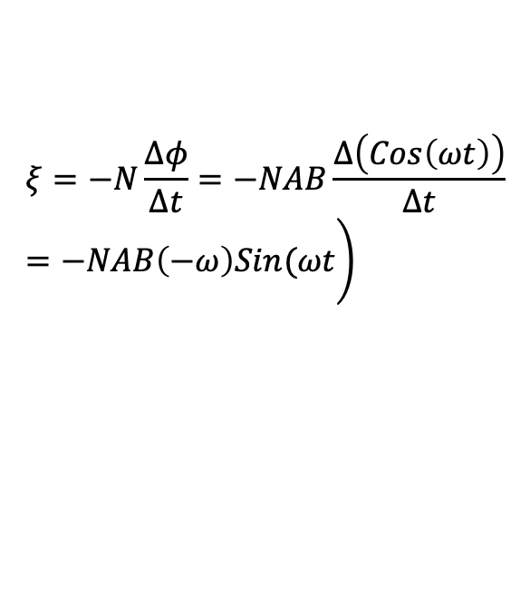
AC generator
$$\left.B_{per}=BCos\left(θ\right)=BCos(ωt\right)$$
$$\left.φ=AB_{per}=ABCos(ωt\right)$$
$$\left.ξ=−N\frac{Δφ}{Δt}=−NAB\frac{Δ\left(Cos\left(ωt\right)\right)}{Δt}=−NAB\left(−ω\right)Sin(ωt\right)$$
$$\left.ξ=NABωSin(ωt\right)$$

Slide 11
AC generator

Slide 12
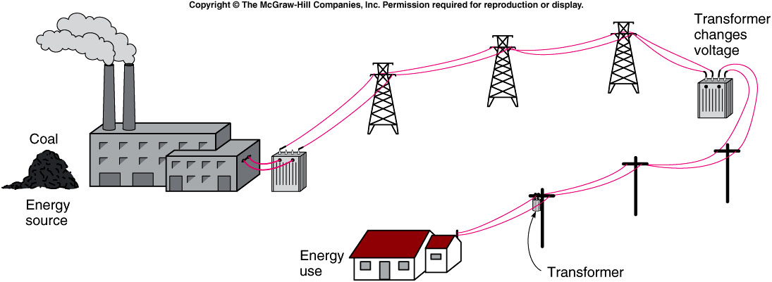
Transformers and Electricity

Slide 13
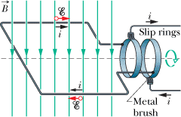
Transformers and Electricity

Slide 14
Transformers and Electricity
A transformer is a device for increasing or decreasing an ac voltage.

Slide 15
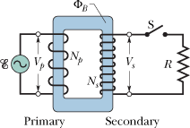
Transformers and Electricity
A transformer is a device for increasing or decreasing an ac voltage.

Slide 16
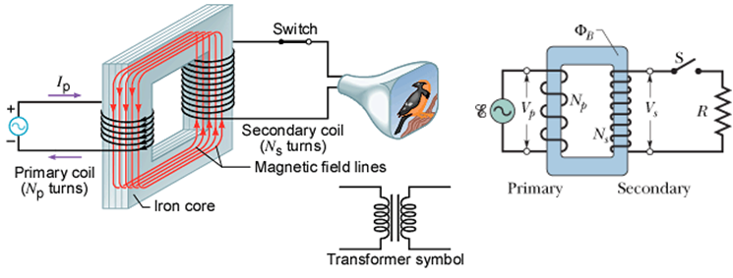
Transformers and Electricity
A transformer is a device for increasing or decreasing an ac voltage.

Slide 17

Transformers and Electricity
A transformer is a device for increasing or decreasing an ac voltage.
$$ξ=−N\frac{Δφ}{Δt}$$

Slide 18
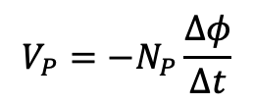
Transformers and Electricity
A transformer is a device for increasing or decreasing an ac voltage.
$$ξ=−N\frac{Δφ}{Δt}$$
$$V_{P}=−N_{P}\frac{∆φ}{∆t}$$

Slide 19
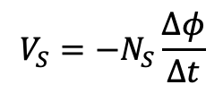
Transformers and Electricity
A transformer is a device for increasing or decreasing an ac voltage.
$$ξ=−N\frac{Δφ}{Δt}$$
$$V_{P}=−N_{P}\frac{∆φ}{∆t}$$
$$V_{S}=−N_{S}\frac{∆φ}{∆t}$$

Slide 20
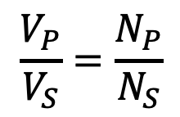
Transformers and Electricity
A transformer is a device for increasing or decreasing an ac voltage.
$$ξ=−N\frac{Δφ}{Δt}$$
$$V_{P}=−N_{P}\frac{∆φ}{∆t}$$
$$V_{S}=−N_{S}\frac{∆φ}{∆t}$$
$$\frac{V_{P}}{V_{S}}=\frac{N_{P}}{N_{S}}$$

Slide 21
Transformers and Electricity
A transformer is a device for increasing or decreasing an ac voltage.
$$ξ=−N\frac{Δφ}{Δt}$$
$$P_{P}=P_{S}$$
$$V_{P}=−N_{P}\frac{∆φ}{∆t}$$
$$V_{S}=−N_{S}\frac{∆φ}{∆t}$$
$$\frac{V_{P}}{V_{S}}=\frac{N_{P}}{N_{S}}$$

Slide 22
Transformers and Electricity
A transformer is a device for increasing or decreasing an ac voltage.
$$ξ=−N\frac{Δφ}{Δt}$$
$$P_{P}=P_{S}$$
$$V_{P}=−N_{P}\frac{∆φ}{∆t}$$
$$I_{P}V_{P}=I_{S}V_{S}$$
$$V_{S}=−N_{S}\frac{∆φ}{∆t}$$
$$\frac{V_{P}}{V_{S}}=\frac{N_{P}}{N_{S}}$$

Slide 23
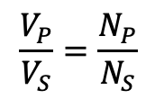
$$\frac{V_{P}}{V_{S}}=\frac{N_{P}}{N_{S}}$$
$$I_{P}V_{P}=I_{S}V_{S}$$
[CJ10-Ch22-P67] A generating station is producing 1.2 MW of power at 1200 V that is to be sent to a small town located 7.0 km away. Each of the two wires that comprise the transmission line has a resistance per kilometer of length of 0.05 Ω/km. (a) Find the power lost in heating the wires if the power is transmitted at 1200 V.
(b) A 100:1 step-up transformer is used to raise the voltage before the power is transmitted. How much power is now lost in heating the wires?
,

